Slide 1
OOP & Linked Lists
TIP101
Notes:
🌟 Purpose: Welcome students and introduce the session’s topics.
✅ What should I be doing?
Set an enthusiastic tone for the session.
Highlight the importance of OOP and linked lists in Python.
🎙️ What should I be saying?
Welcome to Week 5, Session 1 of TIP101! Today, we’ll explore object-oriented programming (OOP) and dive into linked lists—two fundamental concepts for solving problems effectively in Python.
By the end of this session, you’ll have a solid understanding of how to use classes and linked lists to model and solve complex problems.
🙌🏽 How should I engage students?
Ask: "What’s one thing you’ve always wondered or struggled with regarding OOP or linked lists?"

Slide 2
1 | Welcome 👋🏽 | 10 minutes
2 | OOP in Python | 15 minutes
3 | Linked Lists | 20 minutes
4 | BREAK | 5 minutes
5 | Collaborative Problem Solving | 60 minutes
6 | Wrap Up | 10 minutes
Notes:
🌟 Purpose: Outline the session's structure and set clear expectations.
✅ What should I be doing?
Walk students through the schedule.
🎙️ What should I be saying?
Here’s what we’ll cover today: We’ll start with an overview of OOP in Python, followed by an introduction to linked lists. After a short break, we’ll collaborate on solving problems together, and finally, we’ll wrap up with reflections and reminders.
Today’s focus is on applying these concepts through hands-on practice.
🙌🏽 How should I engage students?
Ask: "Is there anything you’re particularly looking forward to learning or applying today?"

Slide 3
Welcome! 👋🏽
10 minutes

Slide 4


Turn on your cameras
Fill out the entry ticket
Notes:
🌟 Purpose: Encourage visual engagement to foster connection during the session.
✅ What should I be doing?
Prompt students to enable their cameras and submit the entry ticket.
🎙️ What should I be saying?
Let’s kick off our session by turning on our cameras!
Also, don’t forget to fill out the entry ticket to help us organize breakout rooms later.
🙌🏽 How should I engage students?
Use humor or compliments: "Let’s see those smiles!"
Acknowledge and thank students who turn on their cameras.

Slide 5
5 minutes
🐶Question:
Whether you are a dog person or a cat person (or both!), do you have any pets, and if so how many of what kind?
💬Answer:
Share your answer in the Zoom chat below. What kinds of pets do you have if any? If you don’t have any, share what type you would like to have, if any.

Slide 6
Students valued Big(O) practice
Students learning to plan before implement
Explaining reasoning to others
- Spend more time on Big O practice
- Reminder to reach out to us during breakout rooms
Notes:
🌟 Purpose: Share feedback from the previous session and highlight areas of success and improvement.
✅ What should I be doing?
Summarize feedback from the previous session's survey and present key takeaways.
🎙️ What should I be saying?
From your feedback, it seems many of you enjoyed [highlighted aspect]. One suggestion was [area for improvement]. We’ll work on that today.
🙌🏽 How should I engage students?
Ask: "Does anyone have additional feedback or suggestions?"

Slide 7
OOP in Python
15 minutes

Slide 8


What is a class?
A class is a blueprint for creating objects.
Classes encapsulate data for the object and methods to manipulate that data.
Notes:
🌟 Purpose: Introduce the concept of classes as blueprints for objects.
✅ What should I be doing?
Explain the basics of classes and their role in OOP.
🎙️ What should I be saying?
A class is a blueprint for creating objects. It defines attributes and methods that describe the data and behaviors of an object.
For example, a class for a car might include attributes like color and make, and methods like start and stop.
🙌🏽 How should I engage students?
Ask: "Can you think of a real-world object that could be modeled as a class? What attributes and methods would it have?"

Slide 9
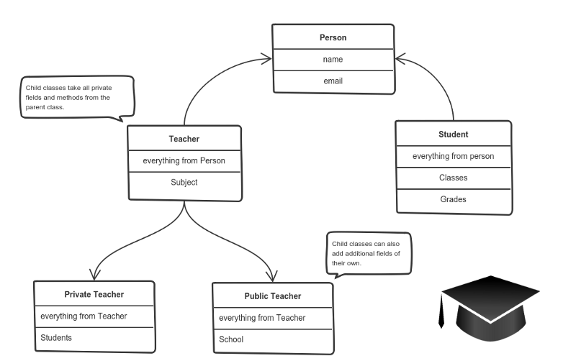
Why do we use classes?
Classes are fundamental to object-oriented programming (OOP).
They help in modeling real-world entities, making code reusable, and organizing complex programs.
Notes:
🌟 Purpose: Explain the benefits of using classes in programming.
✅ What should I be doing?
Highlight how classes help organize and reuse code.
🎙️ What should I be saying?
Classes are fundamental to OOP because they help us model real-world entities, organize code logically, and make our programs more reusable and maintainable.
For instance, if you’re creating a game, you might have a class for a Player that can be reused to create multiple players.
🙌🏽 How should I engage students?
Prompt: "Can you think of a scenario where using a class made your code more efficient or easier to manage?"

Slide 10
Built-in Python Classes
Strings: immutable sequences of characters
Lists: mutable sequences used to store collections of items
Dictionaries: collections of key-value pairs
Notes:
🌟 Purpose: Demonstrate how Python’s built-in classes serve as practical examples of OOP.
✅ What should I be doing?
Show how common data structures like strings, lists, and dictionaries are implemented as classes in Python.
🎙️ What should I be saying?
Python’s built-in classes, like strings, lists, and dictionaries, are great examples of OOP in action. They encapsulate data and provide methods to manipulate that data efficiently.
For example, a string is immutable, but it has methods like .upper() and .replace() to create modified versions of itself.
🙌🏽 How should I engage students?
Ask: "Which built-in Python class do you use the most, and why?"

Slide 11
Instantiation
my_string = "Hello, World!"
my_list = [1, 2, 3, 4, 5]
my_dict = {"key": "value"}
Instantiation is the process of creating an instance (object) of a class.
When a class is instantiated, a new object is created with its own set of attributes and methods.
Notes:
🌟 Purpose: Explain the concept of instantiation in object-oriented programming and demonstrate how to create instances of built-in and custom classes.
✅ What should I be doing?
Introduce the process of instantiation and its role in creating objects.
Use examples to show how built-in classes like str, list, and dict are instantiated.
Explain how instantiation works for custom classes.
🎙️ What should I be saying?
Instantiation is the process of creating an instance, or object, from a class. Think of a class as a blueprint, and instantiation as the step where you build something tangible from that blueprint.
For example, when we create a string with my_string = 'Hello, World!', we’re instantiating the built-in str class. Similarly, creating a list with my_list = [1, 2, 3] is instantiating the list class.
For custom classes, the __init__ method is called during instantiation to initialize the object’s attributes.
Example: "Let’s define a simple custom class and create an instance of it." class MyClass:
def __init__(self, name):
self.name = name
my_object = MyClass('Python')
print(my_object.name) # Output: Python
🙌🏽 How should I engage students?
Ask: "What are some examples of objects you’ve instantiated in your previous coding experience?"
Prompt: "What do you think happens when you try to instantiate a class without defining an __init__ method?"
Encourage students to experiment: "Try defining a simple class with attributes and instantiate it in your own editor. What attributes or methods would you include?"

Slide 12
Creating a Custom Class
A class is defined using the class keyword followed by the class name.
class MyClass:
def __init__(self, param1, param2):
self.param1 = param1
self.param2 = param2
def my_method(self):
return self.param1 + self.param2
The __init__ method initializes the object's attributes.
Methods are defined within the class to perform actions on the object's data.
Notes:
🌟 Purpose: Walk students through defining and using a custom class.
✅ What should I be doing?
Demonstrate creating a custom class with attributes and methods.
🎙️ What should I be saying?
Let’s create a custom class to see how OOP works in action. For example, we can define a class MyClass with attributes and a method to perform operations on those attributes.
This allows us to encapsulate data and behavior in a single, reusable structure.
🙌🏽 How should I engage students?
Encourage students to try creating their own class: "What attributes and methods would you include if you were designing a class for a task tracker?"

Slide 13
Linked Lists
20 minutes

Slide 14
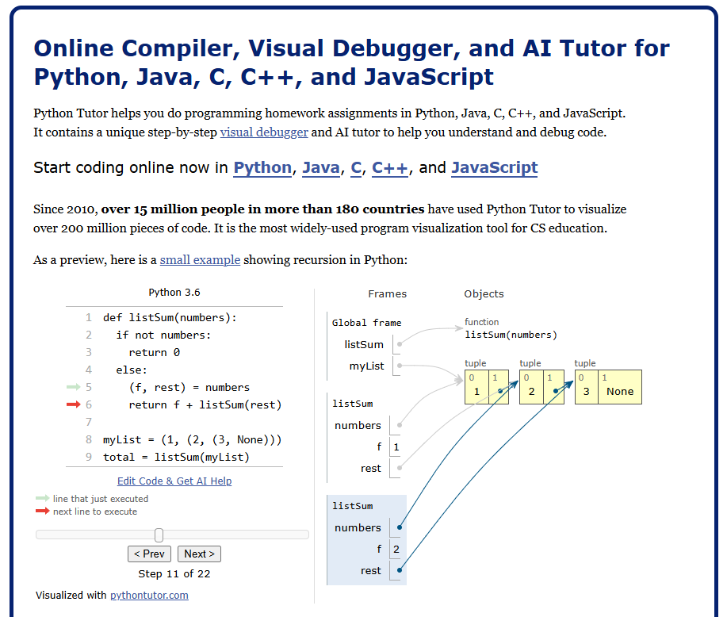
Python Tutor
https://pythontutor.com/
You won't be able to use this in an interview, but this is a great visualization of tracing code.
Use it today in your breakout rooms to check against what you think should be occurring!
Notes:
https://pythontutor.com/
🌟 Purpose: Introduce Python Tutor as a tool for visualizing code execution using a simple example, laying the foundation for understanding more complex concepts later.
✅ What should I be doing?
Demonstrate how Python Tutor can trace code execution step by step using a straightforward example.
Highlight how Python Tutor visualizes variable states, loops, and function calls.
Emphasize its value as a learning tool for debugging and understanding code behavior.
🎙️ What should I be saying?
"Python Tutor is a fantastic tool for visualizing how Python code executes step by step. It’s great for understanding how variables change, how loops and functions work, and how data structures evolve during execution."
"Let’s start with a simple example to see how it works. We’ll use a small program that calculates the sum of numbers in a list and prints each intermediate step."
Demo Instructions
Example Code: numbers = [1, 2, 3, 4, 5]
total = 0
for num in numbers:
total += num
print(f"Adding {num}: Current total is {total}")
print(f"Final total: {total}")
Steps:
Copy and paste this code into Python Tutor.
Explain each step as you click through:
"Here’s the initial state, with numbers as our list and total set to 0."
"As we loop through numbers, Python Tutor shows how total updates after each iteration."
"We can also see how the value of num changes with each iteration of the loop."
Discussion:
Point out the clear visualization of variables and memory.
Highlight how Python Tutor can help trace logic errors, such as missing updates to variables.
🙌🏽 How should I engage students?
Ask: "What do you notice about how Python Tutor represents the loop and variable updates?"
Prompt: "What do you think will happen if we remove the total += num line? Let’s try that and see what Python Tutor shows us."
Encourage: "Try using Python Tutor for any code you’re unsure about—it’s a great way to debug and understand behavior step by step."

Slide 15
Arrays vs Linked Lists
Arrays cannot dynamically grow, but linked lists can!
2
4
8
1
3
2
4
8
1
3
Notes:
🌟 Purpose: Compare arrays and linked lists to highlight their differences and use cases.
✅ What should I be doing?
Explain the advantages and limitations of each data structure.
🎙️ What should I be saying?
Arrays are great for accessing elements quickly by index, but they have a fixed size. Linked lists, on the other hand, can grow dynamically and are better for frequent insertions and deletions.
Imagine an array as a row of lockers—you can access any locker directly, but adding a new one requires rearranging the entire row. A linked list is like a chain, where adding or removing links is much easier.
🙌🏽 How should I engage students?
Ask: "Can you think of a problem where a linked list would be a better choice than an array?"

Slide 16
Example
class Node:
def __init__(self, value):
self.value = value
self.next = None
x = Node(2)
print(x.value)
In Python Tutor:
Create a Node class.
Go through the steps to see what happened.
Notes:
🌟 Purpose: Introduce the concept of nodes as the building blocks of linked lists.
✅ What should I be doing?
Demonstrate defining a Node class and initializing instances.
🎙️ What should I be saying?
A linked list is made up of nodes, each containing a value and a pointer to the next node. Let’s create a simple Node class to represent these building blocks.
This is a great opportunity to see how OOP and data structures come together.
🙌🏽 How should I engage students?
Prompt students: "What attributes or methods might we want to add to this Node class to make it more useful?"

Slide 17
Example
class Node:
def __init__(self, value):
self.value = value
self.next = None
x = Node(2)
y = Node(4)
print(x.value)
In Python Tutor:
Add a Node.
Go through the steps again to see what has changed.
Notes:
🌟 Purpose: Show how to add nodes to a linked list and visualize the process.
✅ What should I be doing?
Use Python Tutor or a whiteboard to demonstrate the linking process.
🎙️ What should I be saying?
Let’s add nodes to our linked list and connect them. Each node will point to the next, forming a chain.
This is where pointer management becomes critical—losing track of a pointer can break the entire list.
🙌🏽 How should I engage students?
Ask: "What do you think happens if we forget to update a pointer? How could we debug that?"

Slide 18
How can we connect x to y?
Notes:
🌟 Purpose: Engage students in understanding the process of linking nodes in a linked list through a guided discussion.
✅ What should I be doing?
Facilitate a discussion about how to connect two nodes (x and y) in a linked list.
Encourage students to think critically about pointer manipulation and its role in creating the list structure.
🎙️ What should I be saying?
Now that we’ve seen how to create nodes in a linked list, let’s discuss how we can connect two nodes, x and y, so that x points to y.
This involves updating the next attribute of x to reference y. In code, this would look like x.next = y.
Once connected, x becomes the head of the linked list, and y is the next node in the sequence.
Why is it important to update the next attribute correctly? If we forget to do this, x will not point to y, and our list will not be properly linked.
🙌🏽 How should I engage students?
Ask: "What do you think happens in memory when we write x.next = y? Can anyone explain it in their own words?"
Prompt: "What would happen if we accidentally set x.next = None instead of linking it to y?"

Slide 19
Example
class Node:
def __init__(self, value):
self.value = value
self.next = None
x = Node(2)
y = Node(4)
x.next = y
y = None
print(x.value)
Go through the steps in Python Tutor. What's changed?
Notes:
🌟 Purpose: Demonstrate how to add nodes to a linked list and visualize the changes using Python Tutor.
✅ What should I be doing?
Use Python Tutor to show the process of adding nodes to a linked list.
Highlight how pointers are updated when linking nodes together.
Explain each step of the process to help students understand how linked lists function.
🎙️ What should I be saying?
Let’s see how we can add nodes to a linked list and connect them to form a chain. Each node will have a value and a pointer to the next node in the list.
We’ll use Python Tutor to trace the code step by step and visualize how the nodes and pointers change in memory.
Example Code: class Node:
def __init__(self, value):
self.value = value
self.next = None
# Creating nodes
x = Node(2)
y = Node(4)
# Linking nodes
x.next = y
# Printing values
print(x.value) # Output: 2
print(x.next.value) # Output: 4
As we run this in Python Tutor, notice how the pointer in x points to y, effectively linking the nodes.
This process is crucial for creating and maintaining linked lists in your programs.
🙌🏽 How should I engage students?
Ask: "What do you notice about how Python Tutor represents the pointers and nodes? Does anything surprise you?"
Prompt: "What do you think will happen if we forget to update a pointer? Let’s test that and see the result."

Slide 20
Finding a Node
current = a
while current != None:
print (current.value)
current = current.next
Go through the steps in Python Tutor to trace the code.
Notes:
🌟 Purpose: Teach how to traverse a linked list to find a specific value.
✅ What should I be doing?
Demonstrate traversing the list and explain the importance of pointer bookkeeping.
🎙️ What should I be saying?
To find a node, we start at the head and follow the pointers until we reach the target value or the end of the list.
Let’s walk through the code in Python Tutor to see how each step works.
🙌🏽 How should I engage students?
Prompt: "What challenges might arise when traversing a linked list, and how can we address them?"

Slide 21

Break Time!
Take 5 mins to step away from the computer. Feel free to turn off your camera and return promptly after 5 mins.
Notes:
🌟 Purpose: Provide a short break to refresh and re-energize.
✅ What should I be doing?
Announce the break and remind students to return on time.
Play the countdown timer video (be sure to share sound).
🎙️ What should I be saying?
Let’s take 5 minutes to step away from the screen. Be sure to return promptly.

Slide 22
Collaborative Problem Solving
60 minutes

Slide 23
60 minutes
🏃🏽 Navigate to your breakout room.
👋🏽 Introduce yourselves!
🧑🏽‍💻 Work on the problems for your selected unit.

Slide 24
Wrap Up
10 minutes

Slide 25
Notes:
🌟 Purpose: End the session on a positive note.
✅ What should I be doing?
Prompt students to share their reflections in the chat.
🎙️ What should I be saying?
Let’s celebrate your wins. Share one good thing you learned or accomplished today!
🙌🏽 How should I engage students?
Read a few responses aloud and celebrate with enthusiasm.

Slide 26


Session Survey Time!
Notes:
🌟 Purpose: Gather feedback to improve future sessions.
✅ What should I be doing?
Share the survey link and emphasize its importance.
🎙️ What should I be saying?
Your feedback helps us make these sessions even better. Please take a moment to complete the survey.
🙌🏽 How should I engage students?
Thank students for their input and explain how feedback has been used in the past.

Slide 27

Final Reminders
Finish the problem sets for additional practice
Take the weekly HackerRank assessment by Sunday @ midnight
Visit a Study Hall Session to deepen your understanding, work through challenges, and connect with course material alongside your peers!
Mock Interview on Thursday! 1 student volunteer interviewing with me!
Notes:
🌟 Purpose: Reinforce key tasks and deadlines.
✅ What should I be doing?
Summarize next steps and encourage continued engagement.
🎙️ What should I be saying?
Don’t forget to complete the problem sets and take the HackerRank assessment by Sunday!
🙌🏽 How should I engage students?
Encourage students to ask any lingering questions before signing off.

